Slide 1

POL 2012: Theories and Models in Political Economy
Keynesian economics
«Modern political economy»
Espen Moe
Department of Sociology and Political Science
espen.moe@ntnu.no, #9587, 73592230

Slide 2
Keynesian economics
A coherent, rigid school of economics
John Maynard Keynes (1883-1946)
The grand old man of 20th c economics
WWI: Versailles Treaty
Capitalism «morally objectionable»
A Treatise on Money (1930)
The General Theory of Employment, Interest and Money (1936)
Extremely influential. Key to understanding post-war European fiscal policy (and to some extent US)
Reformist
Close to a synthesis neoclassical-Keynesian
Competitors, but populating the same analytic universe

Slide 3
Unemployment
Why bad?
Because not utilizing the full resources of the economy
Government income reduced
Social problems
Medical problems/costs rise
More crime
Neoclassical economics: No unemployment
Unemployment → wages dropping → profits rising → employers hire more workers → unemployment is eliminated
Perfect competition → equilibrium will be reached, problem solved
Keynes’ experience
The great crash (1929)
Lasting unemployment (maybe 30%, most Western countries)
Labor markets not clearing
Wages going down, but unemployment still not going down

Slide 4
Historical epoch
Capitalism under pressure
Democracies under pressure
Interwar years
Fascism
Socialism/communism
Weimar Republic squeezed from the left and the right
But not just in Germany
Serious ideological pressure from very different political and economic models, both totalitarian with a very strong state
Norway early 1930s, very radical labor party and slow growth of a nationalist extreme right (Nasjonal Samling)
Depression
Massive and persistent unemployment
Violence, labor riots
From free-trade to protectionism
Post WWI blues… Both politically and economically
Post WWII: Need for reconstruction, need for the state
Social democracy, full employment as political goal
Welfare state

Slide 5
The great crash
Neoclassicals? From crisis will come a new equilibrium. State should stay out and let markets adjust.
Marxists? Capitalist crises are inevitable. Will recur until the end of capitalism. Solution? Revolution and communism
Keynesians? Crises are inevitable UNLESS the state becomes more active by using fiscal policy to stabilize booms and busts

Slide 6
Crisis of demand
Focus moved from supply to demand
What happens if demand is too low?
(Unemployment)
(Neoclassicals: wages will go down, employment up, problem solved. If not, break up unions, which prevent wages from going down.)
Keynesians
Unemployment
(Wages do NOT necessarily go down. Not flexible downwards.)
If wages go down? Problem solved?
NO! Further reducing the demand in the economy
Wages down → demand down → more people unemployed → demand further down → even more people unemployed → demand even further down → …
Vicious circle → no new equilibrium with full employment. Multiplier effect of drop in employment
Permanent underemployment
Lowering wages will just make it harder to break the circle

Slide 7
Solution
Increase demand
How?
Expand aggregated demand for goods and services
Government expenditure
Buildings, schools, roads, railroads
More people employed in construction
Consume more goods
Increasing demand for food, clothes, TVs, washing machinges, etc.
Extra profits in retailing → more jobs in retailing → these people spend more money on food, etc.
Henry Ford
Virtuous circle
But also: Certainly materialist, consumerist. No alternative to neoclassic economics in that sense

Slide 8
Multiplier effect
Aggregate demand: Y = C + I + G + X - M
Government expenditure vs. tax cuts?
Multiplier for govt spending: 1/(1-a)
Multiplier for tax cuts: a/(1-a)
(But tax cuts less inflationary)
Trickle-down?
Dynamic effects?
Lower taxes → people work more?
Lower taxes → expanding the private sector rather than the public sector?

Slide 9
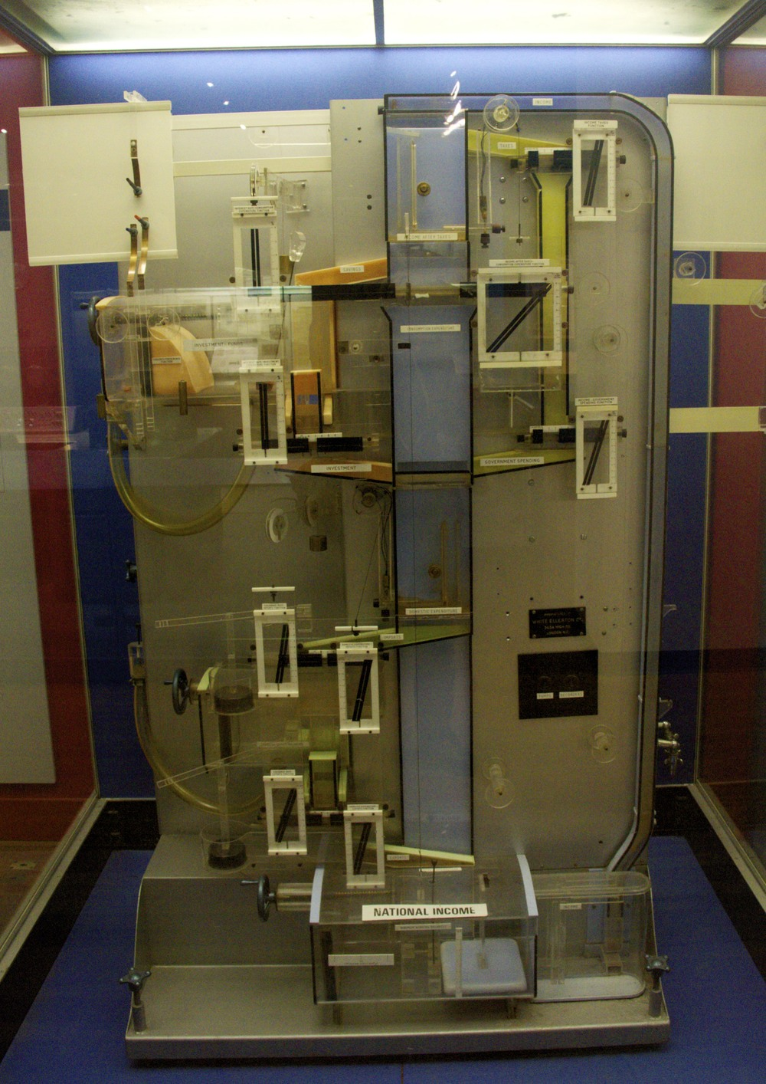
MONIAC
1949
Notes:
Monetary National Income Analogue Computer
1949

Slide 10
«Pre-Keynesians»?
USA: FDR during the depression. Public works projects.
Soviet Union: full employment during Stalin, not suffering any economic crises
(But: Structural change that killed 10m people)
Germany, Italy
Government financing construction: Road building, housing construction
Production of military equipment
Steel industry (e.g. Krupp Stahl)
Enrolling people in the army
World War II!!!

Slide 11
Monetary policy
Money not just a medium of exchange (neocl), but affects the level of economic activity through the money supply
Neoclassicals: Interest rates changes to provide a balance between savings and investment
Keynesians: market interest rates also depend on preference for cash over interest-bearing assets.
Speculators self-fulfilling. Speculation has real effects.
Keynesians: money supply is a policy variable
Increasing money supply → interest rates down → investments up, consumption up, demand up

Slide 12
Managing capitalism
Macroeconomic policy instead of laissez-faire
Govt responsible for national economic performance
Capitalist market economy not self-regulating enough
The state as a instrument for the pursuit of social goals
Confidence in the capacity of the state
National economic accounting
Policy instruments
Fiscal policy
Monetary policy
Incomes policy
Investment and industry policies

Slide 13
Keynesians and neoclassicals
Friends or enemies? Frenemies…?
«Neoclassical synthesis» (neo-Keynesianism?) an uneasy blend of Keynes (macro) and neoclassical (micro) economics
Keynesians accept that there are adjustment mechanisms, that there is a walk towards equilibrium
Keynesians accept the microeconomic neoclassical basics of supply and demand
Keynesian economics is highly analytical. May focus on unemployment, but does so within a framework that is…largely neoclassical
Keyensians take the structure for granted. No desire to change it. Incremental change. No revolution. No classes. No institutions.
But they acknowledge the existence and recurrence of shocks
Possibility of suboptimal, ≈permanent equilibria
And a much more active role for the state

Slide 14
All about unemployment?
NOPE
Inflation
All inflation?
Only inflation that is the consequence of excess aggregate demand
(Employment is too high, labor is scarce)
Fiscal restraint
Reduce government spending
Often times instead: Increase taxes
Often very difficult to reduce spending. New spending often becomes permanent. Public sector jobs often become permanent
Only fiscal policy?
NOPE, monetary policy as well
Also restrict the money supply (although in most countries, this is controlled by the central bank) → interest rates up → demand down

Slide 15
When does it not work?
When the problem is a different one than demand…
If problems in the economy structural rather than demand-side
Keynes and the (current) financial crisis
Austerity vs. stimulus
If already full(ish) employment, no surplus capacity
Inflation/increasing wages
Debt
If inflation?
Well, contractionary fiscal policy a possibility

Slide 16
Legacy
Interventionism
Up until the 1970s, Keynes the hero, but then:
Stagflation. Unemployment AND inflation.
Rational expectations hypothesis
Markets controlled and regulated → economic rigidities
Strong labor unions, strikes
Budget deficits
1980 until 2008, ever more market, supply-side and deregulation
1980s: Monetarism. Milton Friedman.
Stable money supply (slow and steady expansion) and little else.
Govt spending crowds out private investment
Inflation first
Since 2008, state is back in, but is Keynes the right medicine for the disease, or are both the neoclassical and the Keynesian medicine wrong?
Huge (and permanent?) budget deficits and very slow recovery
Post-Keynesians?
Rejection of the market as self-regulating

Slide 17
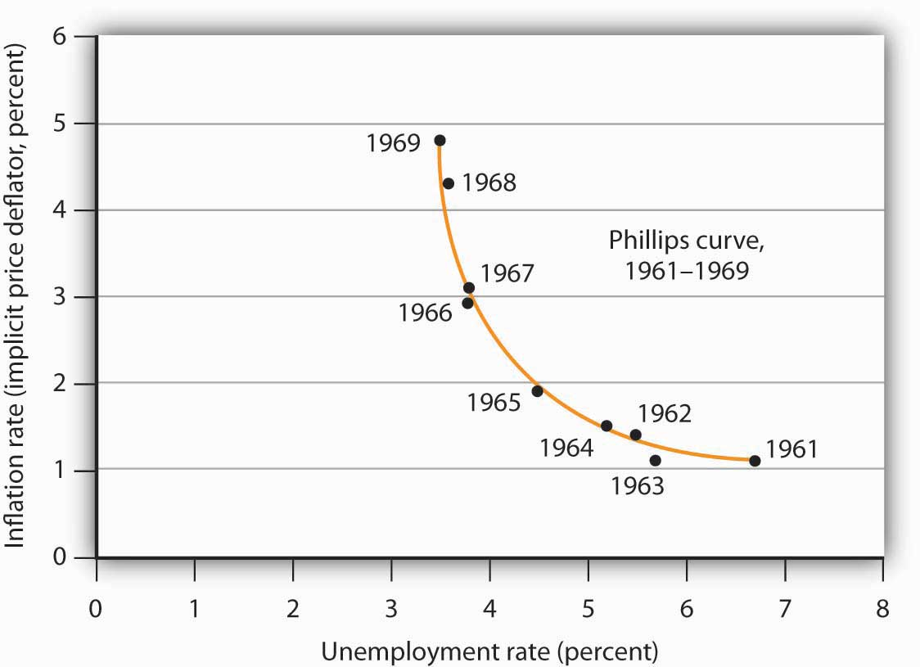
Phillips curve

Slide 18
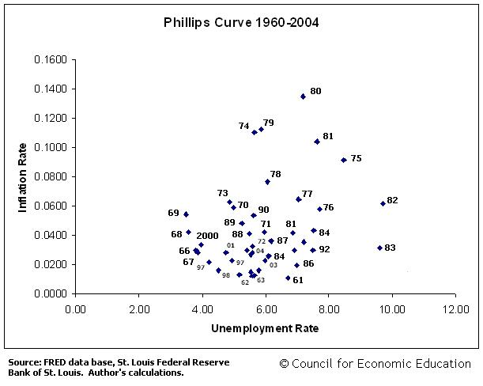

Slide 19
«Modern political economy»
What is it?
Exploring how a more coherent modern political economy can be developed by drawing on existing schools of thought
Objections against the mainstream
Mainstream: Neoclassical + Keynesianism + monetarism + neoliberalism
Dissidents: Marxists + institutionalists + (post-)Keynesians
Common features:
Economic surplus
Relationship between capital, labor and state
Studying change over time rather than static equilibrium
Processes of circular and cumulative causation
How resources are created/destroyed, not just allocated
Exchange→production
Role of politics

Slide 20
Is there such a thing as Modern political economy?
Difficult synthesis…!
Dissident schools a number of major differences
Also, more dissidents!
Not just these three
Feminism, environmentalism
Strong normative elements
Evolutionary economics (next week)
Behavioral economics
Do we simply maximize utility given a budget constraint?
Kahneman: Thinking fast and slow.
Importance of how a question/decision is framed
Ciruclar preferences
Altruism
Consumer is NOT king

Slide 21
«New» themes of political economy
Economy—nature
Economy—technology
Economy—society
Economy—state

Slide 22
Economy—nature
«Newest» of the new trends
Ecological problems in the past as well, but never more than local or temporary
Pollution, overharvesting, floods, draughts, earthquakes
Energy crises (oil crises)
For the first time bumping up against global physical limits
Peak oil? (Resource-exhaustion in general.)
Climate change
Population growth
Fixed within standard neoclassical framework?
Externalities
Using the price-mechanism. Polluter pays. Tradable permits. Carbon taxes
CCS. REDD+.
Natural resource accounting (profit vs. wealth)
Sustainable growth?
Green growth? Green jobs?
Ecological economics
Zero-growth economics

Slide 23
Economy—state
Capacity of governments to deal with the problems of today/tomorrow
Natural world, technology/productivity, class++
Harder to find common ground here
Role of the state?
(Neo-)Mercantilists: Strong state. Foster exports. Regulatory state.
A Smith: Regulatory state stifles enterprise, but colonialism secures bigger markets. State also important for social reasons.
Neoclassicals: Free trade and individual enterprise. Govt correct imperfections in free-market economies
Institutionalists: Consciously engineer and secure cooperation between important interest groups in society.
Keynesians: flaws of free-market economy (i.e. lack of full employment) makes intervention necessary. Govt as stabilizer.
Marxists: State serves the interests of capital. State provides legitimacy to capital interests.
Softer version: Common interests and values between economic and political elites.
Globalization: Threat of capital flight makes the bond even stronger
Anarchists: Voluntary (individual) associations over state coercion. State is oppressive, but not just the capitalist state.
Public choice theory: State a threat because it keeps distributing favors to interest groups in return for political support. Govt failure rather than market failure.
Arena of struggle!

Slide 24
Economy—technology
Technological change at a greater pace than ever
Classic, neoclassic, Marxism(?), Keynes structure as given
Institutionalists interested in technological change
Evolutionary economists very interested in tech change
The driver of the economy
Process of constant structural change
Technological change inscribed in institutions
The information economy, the knowledge economy
But does it change how capitalism works?
Fordism and post-Fordism
Networks, niches, low-scale, hi-skill, autonomous, flexibility
Accompanied by different economic policies(?)
Sphere of production vs. sphere of circulation
Financialization
Short-termism, max shareholder value over long-term results.
Market-agenda over long-term development

Slide 25
Economy—society
Class, gender, ethnicity
Strong Marxist influence
Just another way of thinking class?
More generally: Socioeconomic inequalities
NOT in neoclassical analyses.
Efficiency, not politics…
Implication: Equity comes at an efficiency cost – trade-off
Class
Marx: Not about size of income, but source of income
But «middle class»?
Self-identification
Marx: False!
These are overwhelmingly people who sell their labor power
Not blue-collar vs. white-collar, low-tech or hi-tech, manual or mental
Changing economic conditions have changed the class structure
Privatization and share-ownership
High-wage specialists vs. low-wage non-specialists (+ tech change)
Functional relationship
Flexible relationship
Postmodern Marxism

